Slide 1


Apache Spark: Concept Review
Ana Rocha, Artur Rodrigues, Jean Morelli, Ricardo Correia, Rúben Cruz

Slide 2
Spark: Overview
1
Story, characteristics and architecture
Spark: Overview
Spark: RDD
Spark: Libraries
Spark: Applications
Spark vs Hadoop

Slide 3

Started in 2009 at UC Berkeley
Open Source
Unified analytics engine for large-scale data processing.
Data Processing

Slide 4
Characteristics
Unified API
In Memory
RDD’s

Slide 5
Architecture
Worker Node
Executor
Task
Task
Driver Program
Cluster Manager
SparkContext
Worker Node
Executor
Task
Task

Slide 6
Spark: RDD
2
Spark’s most important concept
Spark: Overview
Spark: RDD
Spark: Libraries
Spark: Applications
Spark vs Hadoop
Notes:
now we will expose one of spark’s most important concepts, the RDD

Slide 7
Resilient Distributed Datasets (RDD)
Worker Node
Spark’s primary form of abstraction
Collection of objects partitioned in a cluster
Allows for great performance and generality
Exposed in a API written in several languages
Fault tolerant
Allow for two types of operations by users
Memory
RDD
Worker Node
Data
Memory
Worker Node
Memory
Notes:
Resilient distributed datasets, also known as RDD is sparks main form of abstraction, abstracting the collection of objects partitioned in a cluster into a single datastructure to ease its parallel manipulation
This system is what allows spark to be a very generalized system while having comparable performance to specialized systems
They are exposed through a functional programming API available in Scala, java, python and R
Are fault tolerant, meaning they can recover from faults if one should occour
Finally users can perform two types of operations on RDD namely(next slide)

Slide 8
RDD operations
Transformations
E.g: map(), filter()
RDD
Lineage
Results in
Results in
Actions
Result
E.g: collect(), count()
Notes:
Transformations, such as map(), and filter(), take an RDD as input and returns an rdd, this is actually a simplification as in truth when using a transformation spark only saves the graph of transformations, also referred as lineage, this graph is simply the order and what transformations were called, after creating the graph of transformations a execution plan is also created , making the evaluation of the transformation operation lazy, as the true value of the rdd is only computed when the other type operation, “action”, is called, this operates on a rdd returning a result based on the called action and in the rdd that the action was called
(about data sharing)
As a rdd is lazy every time an action is called spark recomputes the rdd even if it was previously computed, this can be avoided through data sharing, a feature in spark in which a user can choose to persist a rdd in memory, allowing for rapid reuse of data, without the need to recompute the whole rdd
(about fault tolerance and lineage)
in addition the lazy eval of rdds approach offer benefits such as optimizations on their computing, easier/more modular development of applications due to said optimizations and finally its the process that enables the fault tolerance of rdds, as they can be easily recomputed if a fault is detected

Slide 9
Spark: Libraries
3
Higher-level libraries, targeting the use cases of specialized computing engines
Spark: Overview
Spark: RDD
Spark: Libraries
Spark: Applications
Spark vs Hadoop
Notes:
spark offers a large variety libs all based on the RDD model, making them share the same properties as them, that target many of the usecases of specialized systems, but we are going to present the 4 primary libraries

Slide 10
Higher-Level Libraries
Apache Spark
Spark SQL
Spark Streaming
MLlib
GraphX
Interactive database queries
Real-time data stream processing
Machine Learning
Graph processing
Notes:
Such libs are:
spark sql
implements the ability to process database queries interactively
uses a further level of abstraction called DataFrames, a data structure derived from RDD that abstract a database table with named columns
Spark streaming
allows for the processing of real time data streams in a scalable, high-throughput and fault tolerant manner, using discretized streams model
consists of splitting the input data into small batches that are sent every 200 ms
MLlib
allows for the implementation of machine learning algorithms
includes over 50 common algorithms for distributed model training PLANET, Latent Dirichlet Allocation, Alternating Least Squares matrix factorization
like spark sql MLlib also uses dataframes
and also introduces MLPipelines yet another form of abstraction
GraphX
provides graph computation and processing similar to pregel and graphlab, with similar types of optimizations
these libs are typically used in parallel with each other and in combination of another application of spark

Slide 11
Spark : Applications
4
Batch Processing | Interactive queries | Stream Processing |
Scientific Applications
Spark: Overview
Spark: RDD
Spark: Libraries
Spark: Applications
Spark vs Hadoop
Notes:
now will be presented some of sparks applications among which we have
Tipicamente são combinadas várias bibliotecas oferecidas pelo Spark

Slide 12



Applications: Batch processing
Processing of large datasets
Structuring of raw data
Training of machine learning models
Real world examples:
Notes:
Applications of this type often run only on disk, instead of in memory

Slide 13

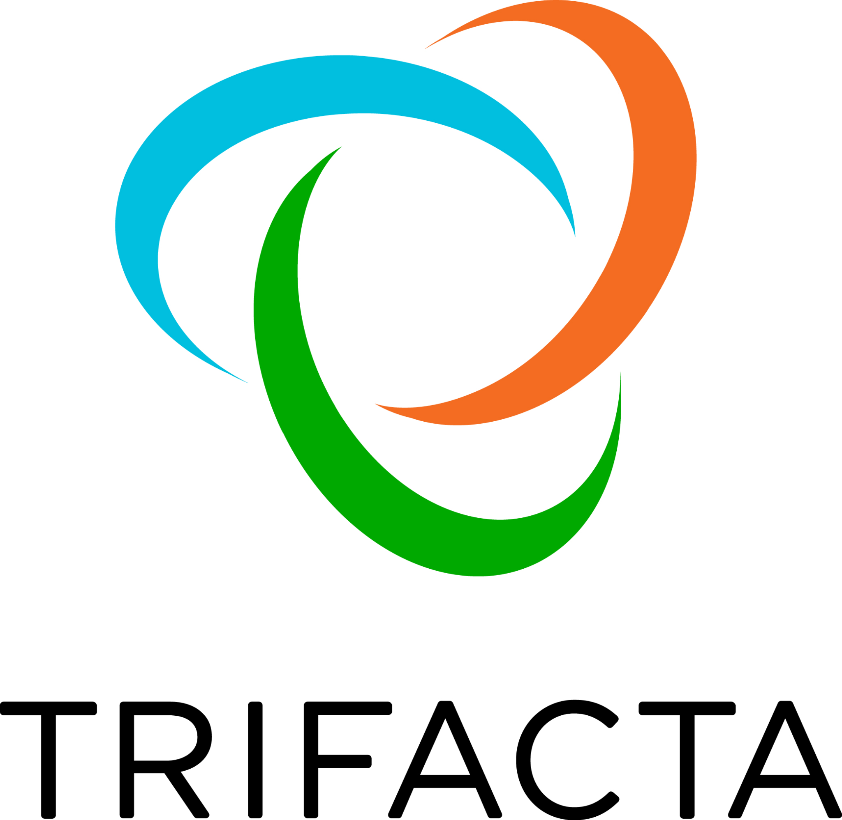

Applications: Interactive queries
Relational queries (Spark SQL)
Use of shells (Spark API)
Domain specific interactive applications
Real world examples:
Notes:
Spark can be used to execute relational queries through spark sql to compute interactive database queries and it allows the execution of the spark api through the use of shells
finally spark allows vendor to develop domain specific interactive apps
examples are
tresata for domain specific
trifacta for domain specific
ebay for relational queries

Slide 14



Applications: Stream Processing
Real time data stream processing
Often combined with batch processing and interactive queries
Real world examples:
Notes:
Popular use case of Spark is real time processing of data
Real world examples:
cisco (network security and monitoring)
neftlix (log mining)
conviva (otimização de vídeo online e análise de vídeo online.)

Slide 15
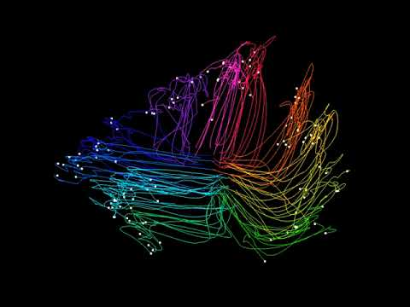
Applications: Scientific Applications
Large Scale Spam detection
Image processing
Genomic data processing
Real world examples:
Thunder. Credit: Jeremy Freeman, Nikita Vladimirov, Takashi Kawashima, Yu Mu, Nicholas Sofroniew, Davis Bennett, Joshua Rosen, Chao-Tsung Yang, Loren Looger, Philipp Keller, Misha Ahrens
Notes:
Dimensionality reduction lets us visualize large neuronal populations by reducing their collective activity to a small number of dimensions. In this video, each trace represents neural activity across the brain during one presentation of a moving stimulus, and different colors indicate different directions of motion. By watching the movie, we see how neural activity evolves over time.
https://www.hhmi.org/news/new-tools-help-neuroscientists-analyze-big-data

Slide 16


Spark: Overview
Spark: RDD
Spark: Libraries
Spark: Applications
Spark vs Hadoop
Notes:
NO CLICK
To adequately analyse the features of Spark, we are going to compare it to his main "competitor", another big-data processing framework called Apache Hadoop.
Before we start comparing the pros and cons of both programming approaches, it's important to clarify what exactly is Hadoop and Map Reduce.
Map Reduce is nothing more than a programming model, introduced by Google [21], whose purpose is dic- tate a way to process and generate large data sets in a scalable, reliable and fault-tolerant way [22]. It essentially consists of two global operations which, as its very own name indicates, are map and reduce. Users are able to specify a map function that processes key/value pairs
To adequately analyse the features of Spark, we are going to compare it to his main "competitor", another big-data processing framework called Apache Hadoop.
Before we start comparing the pros and cons of both programming approaches, it's important to clarify what exactly is Hadoop and Map Reduce.
Map Reduce is nothing more than a programming model, introduced by Google [21], whose purpose is dic- tate a way to process and generate large data sets in a scalable, reliable and fault-tolerant way [22]. It essentially consists of two global operations which, as its very own name indicates, are map and reduce. Users are able to specify a map function that processes key/value pairs outputting another set of intermediate key/value pairs, and a reduce function that essentially merges all the val- ues who follow a certain criteria-set into a single value [21].
Apache Hadoop [23] is essentially an Java open- source implementation of MapReduce, used commonly for many different classes of data-intensive applications. It is composed of two layers, a data storage one via HDFS, and a data processing one, using the Hadoop Map- Reduce implementation. HDFS stands for Hadoop dis- tributed file system and is file system for distributed sys- tems that can be characterized by being highly fault- tolerant and designed using low-cost hardware. [24]
As a way to better organize the analysis of Apache Spark versus Hadoop Map-Reduce, we'll divide the analysis in 9 primary points, which are: Performance, Cost, Fault- tolerance, Data-processing, Ease-of-use, Scability, Security, Machine-learning, and Scheduler.

Slide 17









Cost
Performance
Fault Tolerance
Ease of use
Security
Machine Learning
Scheduling and Resource Management
Data Processing
Scalability
Notes:
As a way to better organize the analysis of Apache Spark versus Hadoop Map-Reduce, we'll divide the analysis in 9 primary points, which are: Performance, Cost, Fault- tolerance, Data-processing, Ease-of-use, Scability, Security, Machine-learning, and Scheduler.

Slide 18


Cost
0.08
0.06
€ / h
0.056
0.04
0.02
0.022
0
Notes:
ONE CLICK
From a cost point-of-view, Apache Hadoop is undeniably less expensive as it only relies on disk memory for its computations. Since Spark requires big quantities of RAM to process and save RDD's in memory, and the cost of RAM is significantly more expensive than disk storage, in the end it ends up costing significantly higher.
Using a more practical example for a high-level point of comparison, if right now you were to choose a compute optimized EMR cluster for Hadoop [26], the cost for the smallest available option would be around 0.022 euros per hour. If we were to do something analogous for Apache Spark, using the smallest-memory cluster opti- mized for Spark [27], the respective cost would be 0.056 euros per hour [3]. Therefore, on a per hour basis, the value for the Hadoop is more than two times cheaper than Spark.
It is, however, important to note that while Spark is indeed the more expensive option, if one was to opti- mize both for computing time, then tasks will usually take less time than the Hadoop cluster.

Slide 19
Performance
140
120
119.53
100
Time (Minutes)
80
60
46.53
40
20
16.1
14.2
1.56
4.14
0
5.8
12.4
43.4
Data Size (GB)
Notes:
ONE CLICK
Apache Hadoop MapReduce has been around for years, being one of the first frameworks for data processing, and is widely used and loved by the community. Over the years it has evolved and improved but Apache Spark can perform 10 to 100 times faster than MapReduce. [24]
Apache Spark outstanding performance of 100 times faster than its competitor is due to the in-memory charac- teristic instead of the disk.

Slide 20
Fault Tolerance
Lineage mechanism
Data replication
Directed acyclic graph
Master node and Slave node

Slide 21
Ease of use
Java,Python, Scala, R, Spark SQL
Java,Python
Interactive mode
Code reusability

Slide 22
Security
Inter-node encryption
Authentication via secret
Kerberus
Apache
Ranger
HDFS file permissions
Authentication via event logging
Service level authorization
HDFS or YARN integration
ACL’s

Slide 23
Machine Learning
MLLib
Mahout
More than 50 common algorithms for distributed model training
Susceptible to serious I/O performance issues

Slide 24
Scheduling and Resource Management
Relies on external solutions to deal with resource management and scheduling issues
Functions are built-in
DAG Scheduler
YARN or third-party plugins like capacityScheduler and FairScheduler.
Spark Scheduler and Block Manager

Slide 25
Data Processing
In-memory data processing using RDD’s
Stores data in disk memory
Splits data into batches and processes parallely with Map-Reduce
RDD’s too big are split into partitions and moved to the closest nodes
Perfect for real-time processing
Perfect for batch processing

Slide 26
Scalability
As the data grows, it inherently scales to accommodate the demands
No native filesystem, so when data grows too large it relies on a external file system implementation.
Relies on disk-memory, which is somewhat cheap nowadays
Incredibly reliant on RAM memory, which is expensive
Able to deal with data in the order of the petabytes
Able to deal with data in the order of the exabytes

Slide 27
Final Thoughts
Leading framework for big data.
In memory and RDD’s
Ideal scenario - Size of datasets smaller than the amount of available RAM

Slide 28
Thanks!
Any questions ?
a63971@ualg.pt | a64591@ualg.pt
a64592@ualg.pt | a64007@ualg.pt
a64014@ualg.pt

